Slide 1





Search Engine Optimization (SEO)
Free SEO Course at Telerik Academy – Introduction
Svetlin Nakov
Senior Technical Trainer
Telerik Corporation
www.telerik.com

Slide 2

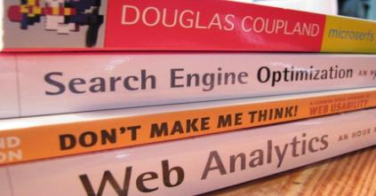
Table of Contents
About Telerik and Telerik Software Academy
What is SEO?
About the SEO Course
Trainers Team
Course Curriculum
Course Schedule and Venue
The Practical SEO Project
Assessment and Certification
Recommended Books

Slide 3

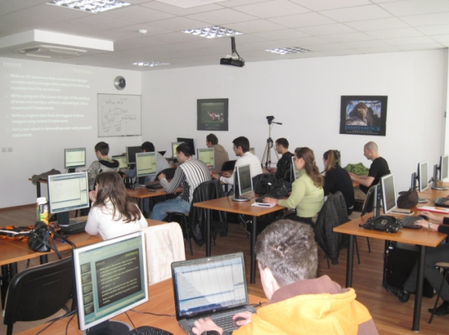

About Telerik and Telerik Academy

Slide 4
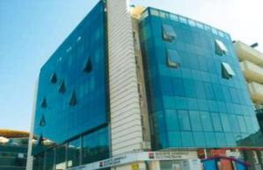
About Telerik
What does Telerik do?
Software development productivity tools
ASP.NET AJAX and MVC, Silverlight, WPF, WP7, Win8 and HTML5 components, ORM, Reporting, CMS Solutions, Productivity Tools, Testing Tools, Agile PM Tools, Mobile Dev Tools
Headquartered in Bulgaria
With offices in USA, Germany, Australia, India
750 employees – mostly developers
Employer #1 in Bulgaria for 2012

Slide 5
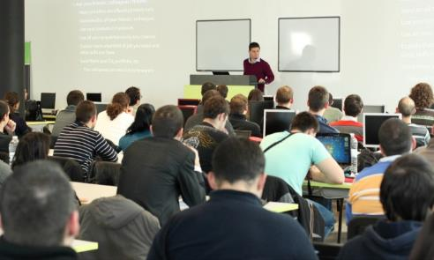
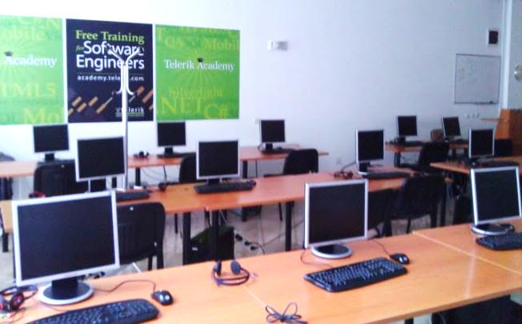

About Telerik Academy
Telerik Academy is an initiative for free training young software engineers
Software Academy: .NET Devs, Web & XAML Front-Ends, QAs, Dev-Supports
Kids Academy
School Academy
Algo Academy
Online Courses
Contests and free initiatives

Slide 6
Learning Tracks
Kids Academy
Online Courses
School Academy
Algo Academy
Software Academy
Programming
HTML & JS
Team Work
Soft Skills
XAML Dev.
Web Dev.
JS Dev.
QA
Dev. Support
Job at Telerik
Another Job

Slide 7





What is SEO?
Search Engine Optimization

Slide 8
What is SEO, SEM, E-Marketing?
Search engine optimization (SEO)
The process of improving the visibility of a Web site or a Web page in the search engines
SEM – search engine marketing means marketing of a Web site (SEO + paid ads)
Internet marketing (Web marketing, e-marketing)
Marketing a product or service through Internet
Includes SEO, SEM, SMM (campaigns in the social networks), paid ads, e-mail marketing, …

Slide 9
Goals and Benefits of SEO
Goals of SEO (and e-marketing in general)
The Web site / page is shown at the top positions in Google / Bing / Yahoo
For certain keywords and search phrases
The Web site / page increases its visitors (customers) and increases its sales
Achieve better branding and reputation for a product / service
Target the audience better
Cut the marketing costs

Slide 10





About the SEO Course
What Will You Learn?
Course Requirements

Slide 11

About the SEO Course
Search Engine Optimization (SEO) course
Provides concepts, techniques, tools and skills for performing SEO
Goals of SEO for your Web site
Better search engine position, more visitors, etc.
Targets school and university students, and any other people interested in SEO technologies
Prepares for a career in the area of Web marketing, SEO, SEM, SMM and PR
Web site: http://seocourse.telerik.com

Slide 12
Requirements to the Students
Desire to learn SEO
Willingness to learn the Web technologies, SEO techniques, tools and technologies
Serious attitude to the course
Put enough effort and time for this course
Work every week on homework and projects
English language
Most training materials are in English
Basic skills in HTML and CMS Systems

Slide 13
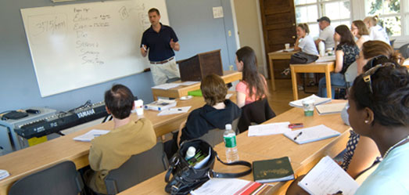
The Trainers Team

Slide 14
Trainers Team
Ognian Mladenov
Famous SEO expert and speaker (SEOM.bg)
Eduard Dimitrov
SEO expert and speaker (3D Web Design)
Dimiter Stamenov
Web developer and SEO expert (SEORanks)
Kalin Karakehayov
Famous SEO expert and speaker (Napred.bg)

Slide 15
Trainers Team (2)
Genadiy Vorobyov
SEO expert and speaker (Optimization.bg)
Evgeni Yordanov
Famous SEO expert and speaker (Webfinity)
Lyubomir Lyubomirov
Copywriter and content editor (Rocket Studio)
Ivo Apostolov
Web project manager (bTV Media Group)

Slide 16
Trainers Team (3)
Teodor Zahariev
SEO expert (StudioKipo.com)
Georgi Mollov
SEO expert (Woptimize.com)
Svetlin Nakov
Manager technical training (Telerik Academy)
See more at http://academy.telerik.com/student-courses/web-design-and-ui/seo-course/lecturers

Slide 17

Course Curriculum

Slide 18


SEO Course Curriculum
Course Introduction
SEO Introduction
Building SEO-Friendly Sites
Copywriting
Link Building
SEO Tools
SEO Evaluation & Planning
SEO & Branding

Slide 19
SEO Course Curriculum (2)
Social Media SEO
Microformats and Vertical Search
Advanced SEO
SEO Test (Preliminary Exam)
Projects Consultations
Projects Defense
See also http://academy.telerik.com/student-courses/web-design-and-ui/seo-course/schedule

Slide 20



Course Schedule & Venue

Slide 21


Course Schedule & Venue
When?
Every Wednesday, 18:30-21:30
Start: 15st of May 2013
Where?
Telerik Academy "Ultimate" Lab
Sofia, 1729, Mladost-1, bul. Alexander Malinov 31, 2nd floor
Online:
http://seocourse.telerik.com

Slide 22
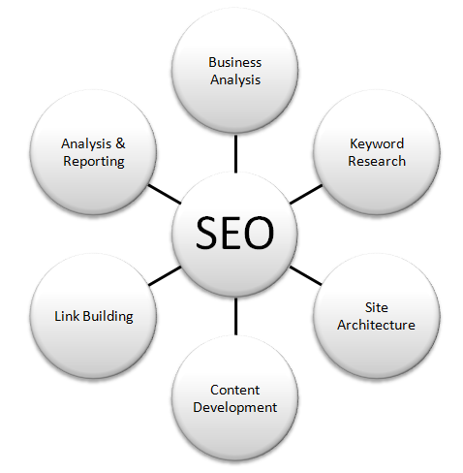

Your SEO Project
Get Practical Experience during the SEO Course

Slide 23
Your SEO Project
Each participant works on own SEO project
Requested during the course registration
Or assigned later by the trainers
At start the initial project state is measured
Daily unique visitors, Alexa rank, etc.
Homework and assignments cover the SEO work needed to be performed
Internal SEO, link building, social SEO, etc.
Each activity is filled in our project template

Slide 24
Your SEO Project (2)
The final project state is measured at the end of the course, just before the project defense
Daily unique visitors, Alexa rank, backlinks, etc.
Projects are defended after the course finishes
Each student presents his initial and final project state and a list of activities performed
Activities done need to be logged in our form
Download the project template from:
http://telerikacademy.com/Courses/Courses/Details/73

Slide 25

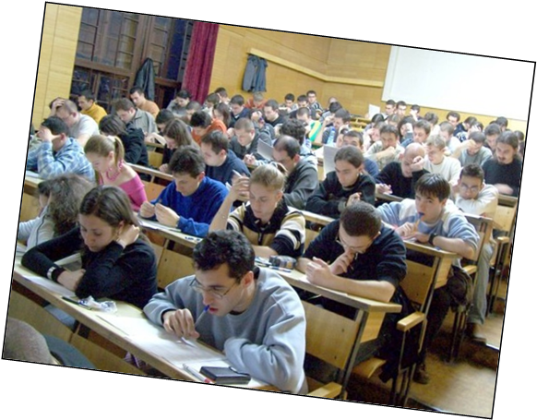
Assessment
Exams, Test, Projects, Grades

Slide 26



Assessment
The course exams consist of regular SEO work (homework), test and a practical SEO project
Students fill their SEO activities regularly in their project template (as a homework)
The practical SEO project will be defended in front of the trainers team

Slide 27
Evaluation and Grades
Test (theory)
Practical project + defense
Only students with high results at the test
Evaluation criteria
Up to 25 points – test
Up to 75 points – practical SEO project score
Up to 10 points – bonus for activities in the forum
Up to 15 points – bonus for exceptional results

Slide 28


Certification and Awards

Slide 29
Certification and Awards
Best students will get certification and awards
Pass HTML, CSS, Slice and Dice, CMS and SEO –academy.telerik.com/academy/majors/seo-practitioner
Certificate of achievement
Certified SEO Practitioner
Requires hard work and outstanding results
Signed by the trainers
Awards
Top 5%-10% students

Slide 30

Recommended SEO Books

Slide 31



Recommended SEO Books
"The Art of SEO: Mastering Search Engine Optimization", Eric Enge, Stephan Spencer, Rand Fishkin and Jessie Stricchiola, O'Reilly Media, 2009, ISBN 9780596518868
"SEO Fast Start", Dan Thies, 2009 (e-book)
English (original) – www.seofaststart.com
Bulgarian (translation) –www.sitershow.com/seo-book
Super Simple SEO, Brenden Clerget, www.mediafire.com/?z8dffe9dghpyaca

Slide 32



Recommended SEO Books (2)
"Making the Most of Your Content: A Publisher’s Guide to the Web", Google, 2007
http://books.google.com/googlebooks/pdf/webmastertools.pdf
"Search Engine Optimization (SEO): An Hour a Day", Jennifer Grappone, Gradiva Couzin, Sybex, 2011, ISBN 9780470902592
"Search Engine Optimization (SEO) Secrets", Danny Dover and Erik Dafforn, Wiley, 2011, ISBN 9780470554180

Slide 33


Free Hosting for Your Projects
Our partners SuperHosting.bg, ICN.bg and Host.bg are happy to offers to all students vouchers for free hosting
1-2 years, free subdomain, minimal parameters
discounts fro domain
More information will come soon in the forum

Slide 34
Search Engine Optimization (SEO) Course – Introduction
?
?
?
?
?
Questions?
?
?
?
?
?
?
http://seocourse.telerik.com

Slide 35



Free Trainings @ Telerik Academy
C# Programming @ Telerik Academy
csharpfundamentals.telerik.com
Telerik Software Academy
academy.telerik.com
Telerik Academy @ Facebook
facebook.com/TelerikAcademy
Telerik Software Academy Forums
forums.academy.telerik.com

